Slide 1

Fighter Analysis
Predicting Match Winners

Slide 2
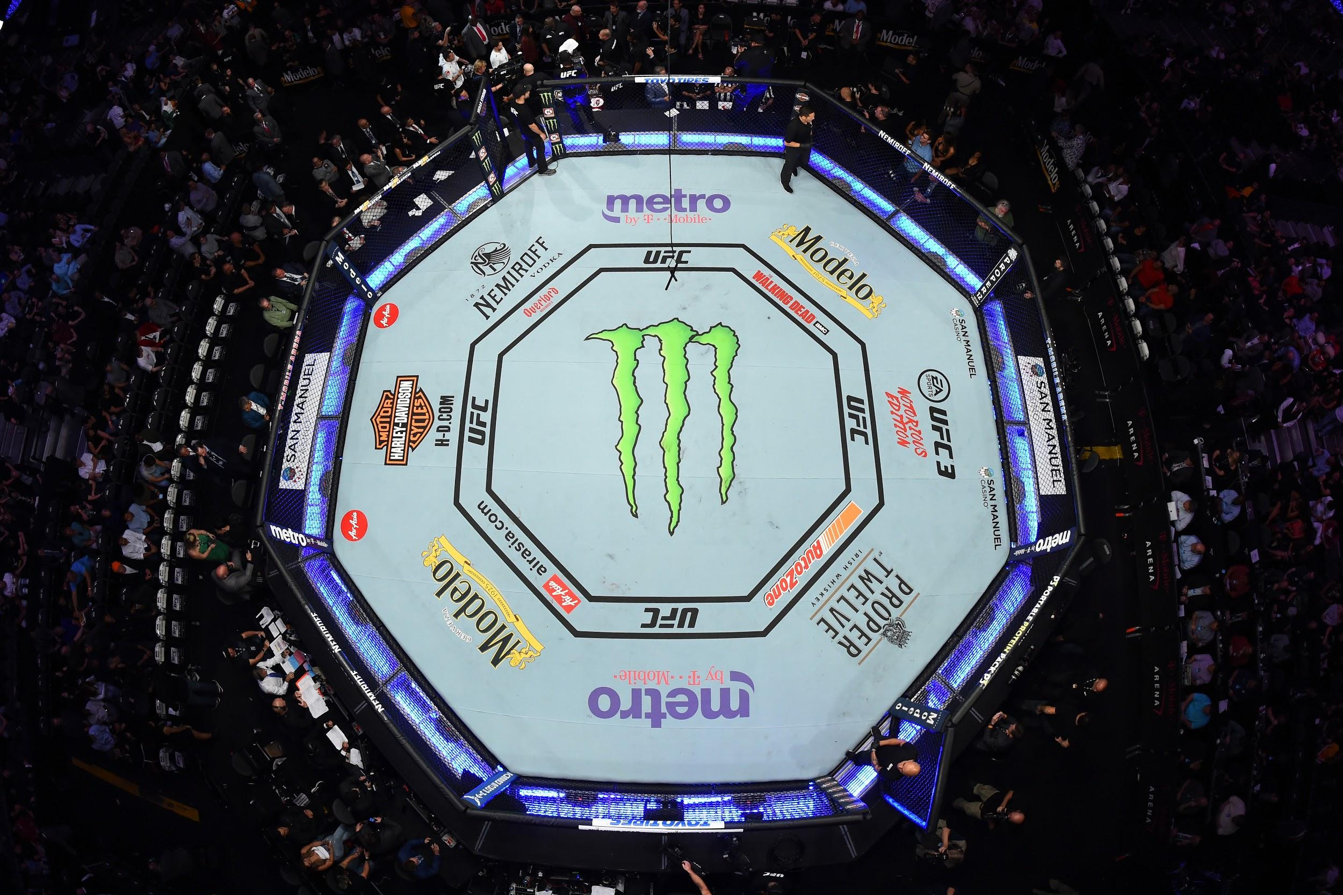
Overview of Project
Our group members are UFC and MMA fans and would like to use the skills we learned in the course to examine fighting techniques to determine which have the most effect the win in a match.

Slide 3
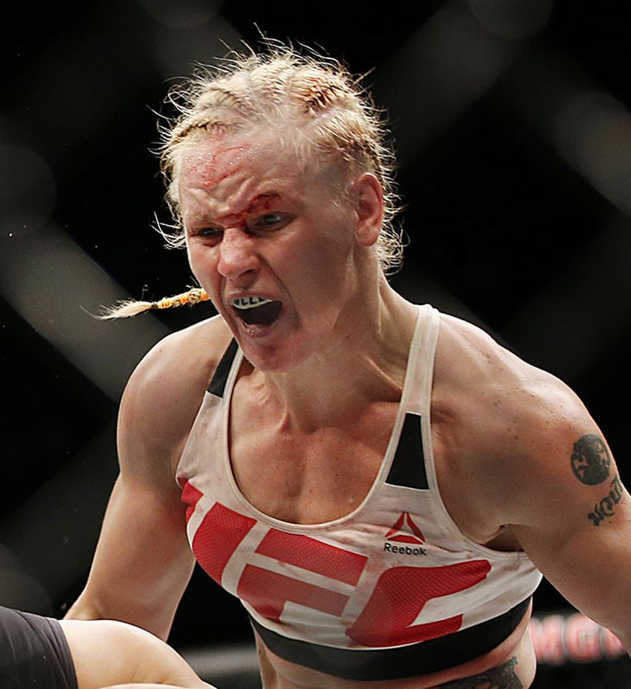
Mixed martial arts (MMA) is a full-contact combat sport based on striking, grappling and ground fighting, incorporating techniques from various combat sports and martial arts from around the world.
Ultimate Fighting Championship (UFC) is a Las Vegas based promotion company that has revolutionized the fighting business since 1993. UFC features some of the highest-level fighters in the sport on its roster and produces events worldwide that showcase twelve weight divisions (eight men's divisions and four women's divisions). As of 2020, the UFC has held over 500 events and grown into a globally popular multi-billion-dollar enterprise.

Slide 4
Purpose of Analysis
Using a Kaggle dataset containing various attributes of UFC fighter stats, fighting techniques and body metrics, we will predict winning fighters with machine learning.
Our CSV file is small (23 columns and 8.990 rows) but complete as it contains roughly every match under the UFC umbrella.
A Git Hub repository was created for the analysis so everyone in the group can contribute and review information.
The group will meet twice a week during our scheduled class sessions on Zoom to work on the project and use our team Slack channel to communicate during the week.

Slide 5
Role Distribution
After establishing the communication structure, we created the foundation for our UFC fighter analysis project by defining roles that play to our individual strengths.
 | Segment 1 | Segment 2 | Segment 3 | Segment 4
Square | Mohammed | Alexandra | Mohammed | Felicia
Triangle | Alexandra | Mohammed | Felicia | Oybek
Circle | Oybek | Oybek | Oybek | Alexandra
X | Felicia | Felicia | Alexandra | Mohammed

Slide 6
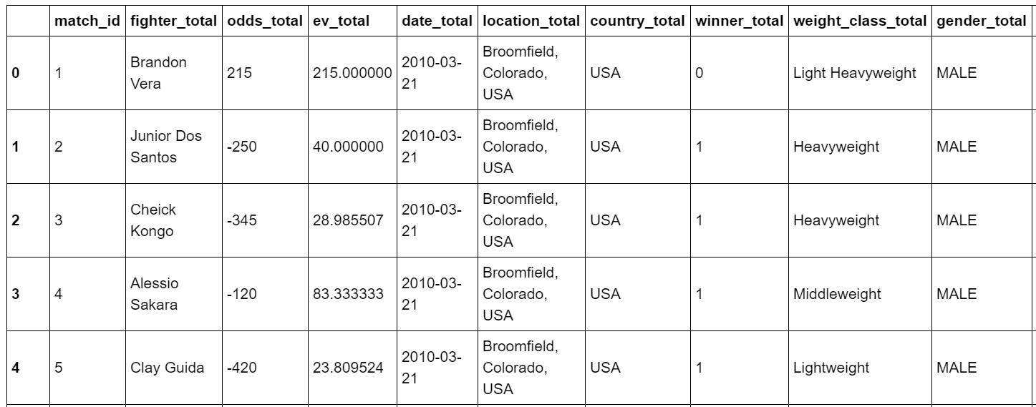
Machine Learning Model
The Dataset:
Source: Kaggle dataset containing UFC fighter winners/losers and their stats (weight, height, stance, technique, odds, gender, finish, etc.)
CSV file: 23 columns and 8,990 rows
Model Goal: use fighter metrics to predict win or loss (winner_total column)

Slide 7
Machine Learning Model
Step 1: Pre-Processing the Model
Data Cleaning - dropped unnecessary columns (fighter name, date of match, and location of match), dropped rows with NaN (754 total rows)
Data Encoding - used OneHotEncoder to encode and read the data into the model
Step 2: Feature Engineering and Feature Selection
Define and split the data into training and testing sets -
y, or the target variable indicates whether or not the fighter won the match and
X, or the independent variables are the metrics that the model uses to predict whether the fighter would win (i.e. gender, class, weight, reach height or odds)
Random Forest Model - We chose the Random Forest Classification Model. Random Forest is our preferred modeling tool because it:
Runs efficiently on large data sets
Works against overfitting
Can be used to rank input variables

Slide 8
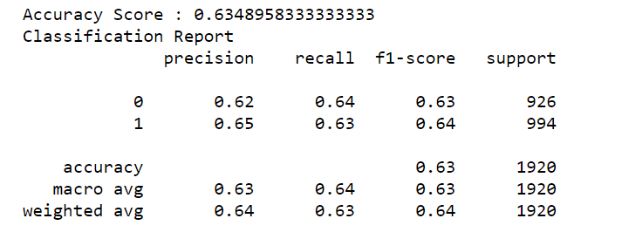
Machine Learning Model
Step 3: Model Results
We performed an exploratory analysis and established a baseline accuracy score of 64%
We decided to use feature selection to find the best attributes to explain the relationship between a fighter’s characteristics and winning matches
A linear regression model helped us identify which variables were most significant.
This removed the noise in our model but the accuracy didn’t improve - maintained 63% accuracy level
We were able to improve the false negatives and positives - making our model more precise
However, there wasn’t enough variation in our dataset to determine which UFC fighter would win the match

Slide 9
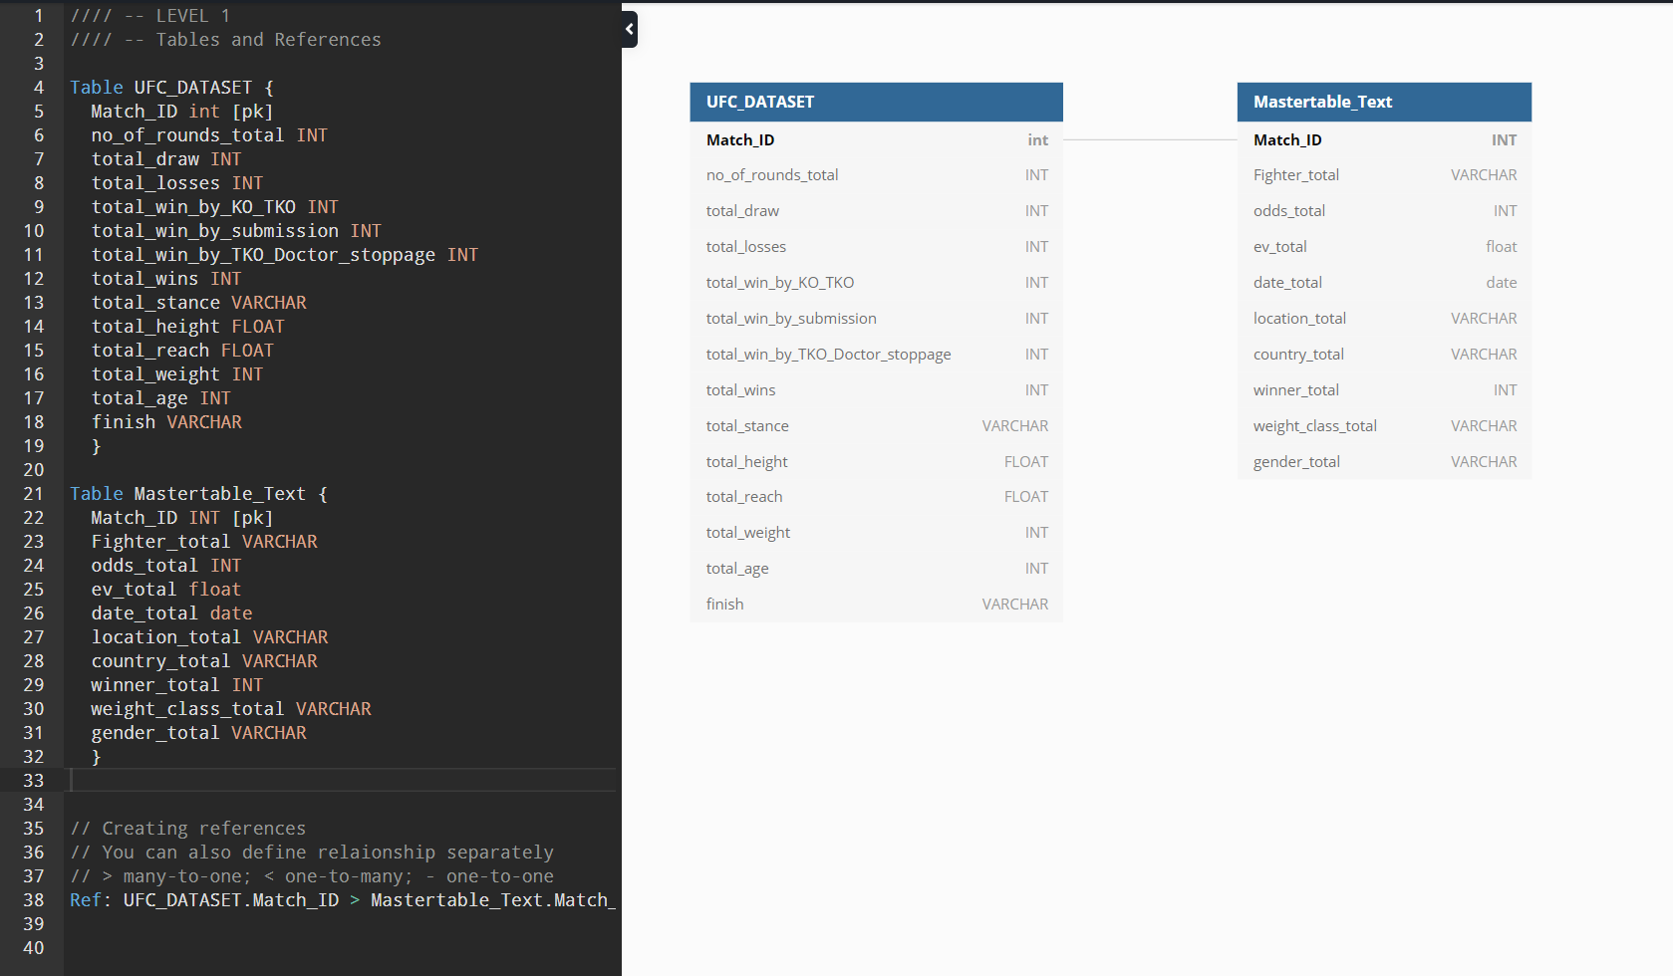
Entity Relationship
Diagram (ERD)
Entity Relationship Diagram. First we created a Entity Relationship Diagram and includes two tables, UFC Dataset and Mastertable_Text, and is joined using Match ID.

Slide 10
Postgres (SQL)
I Created a UFC Database in SQL and connected it with our Notebook in order to use a modified database. I joined two tables (UFC Dataset and Mastertable_Text) and created a final joined table. With that table i made two data outputs. One to show our audience the fighter and their respective countries weight class height and more. The other data i made is to show the wins and losses.

Slide 11
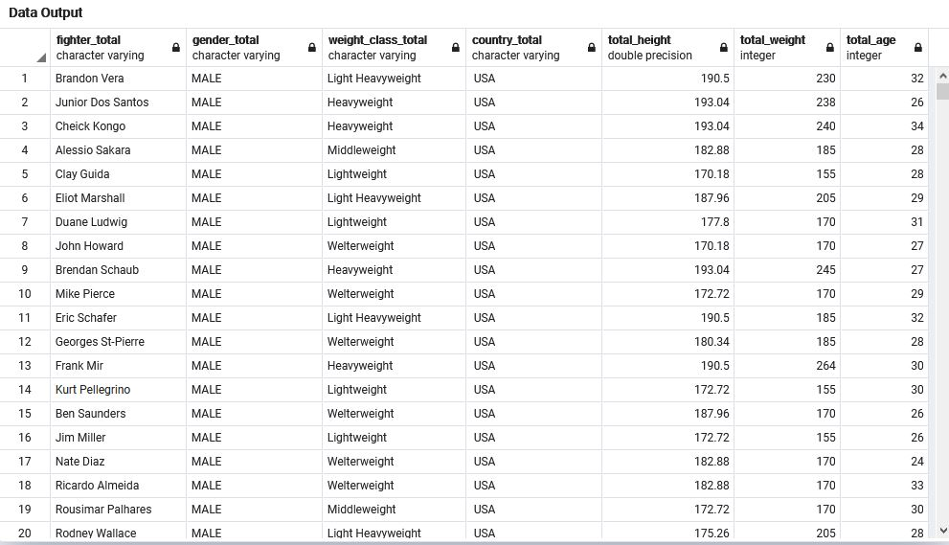
Fighter totals

Slide 12
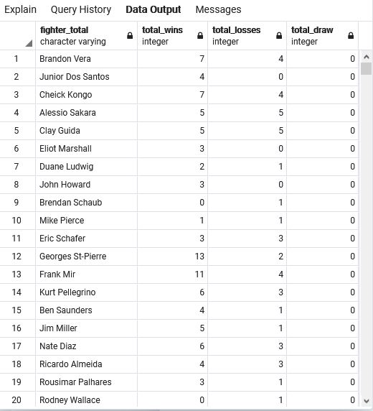
Fighter Wins and Losses

Slide 13
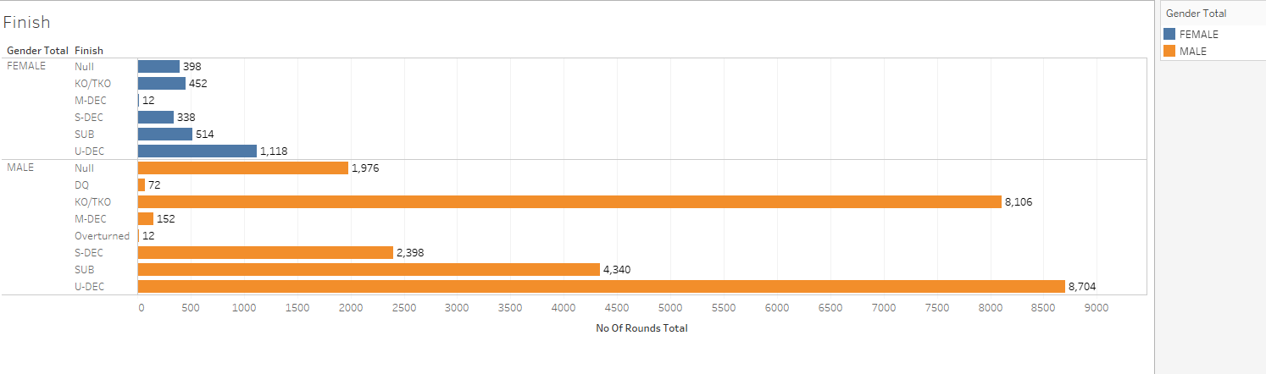
Dashboard / Visualization
KO/TKO - Knockout / Technical Knockout
DQ - Disqualified
M-DEC - Majority decision
Overturned - Result of a fight can be overturned by the athletic commission
Null - No cotest
S-DEC - Split Decision
SUB - A submission is a combat sports term for yielding to the opponent
U-DEC - Unanimous Decision

Slide 14
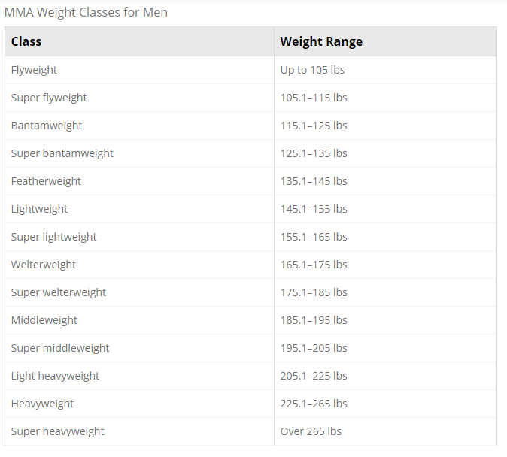
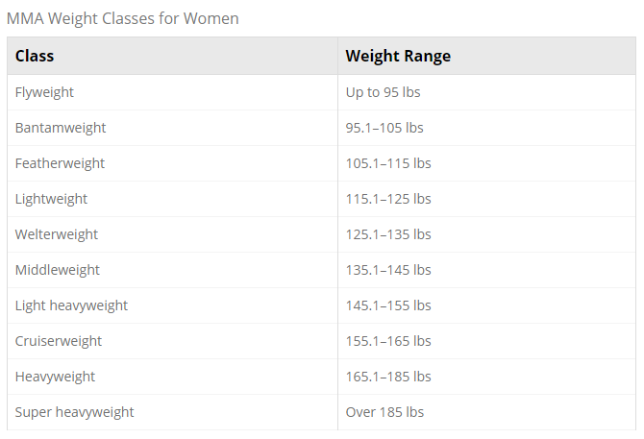
Dashboard / Visualization

Slide 15
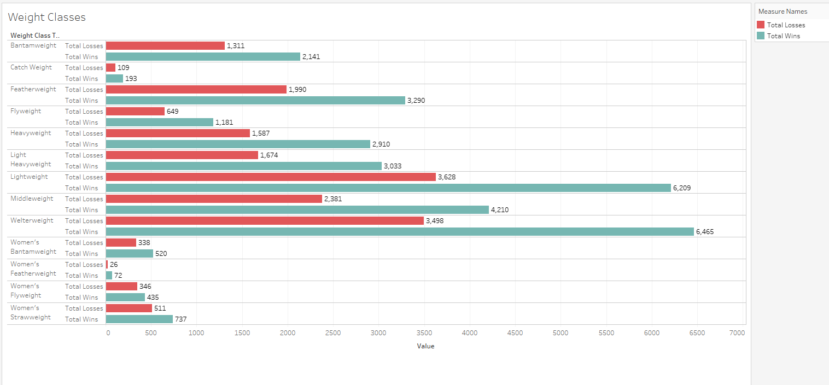
Dashboard / Visualization

Slide 16
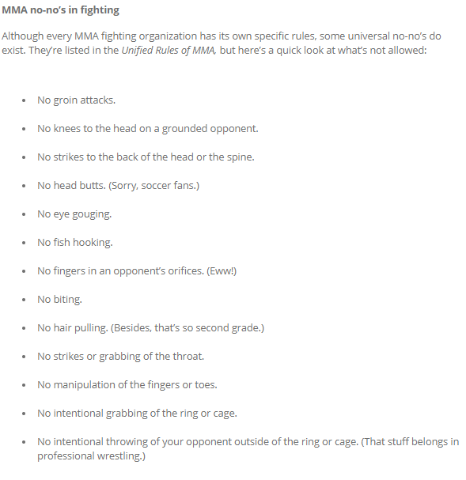

Dashboard / Visualization

Slide 17
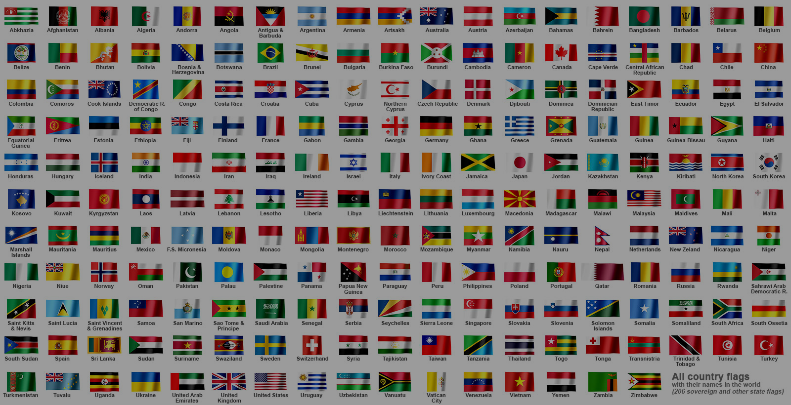
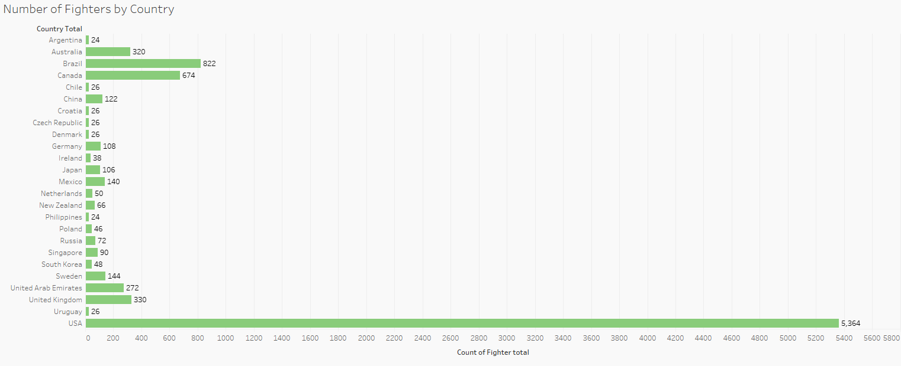
Dashboard / Visualization

Slide 18

Summary
We created the foundation for our UFC fighter analysis project by defining roles that play to our individual strengths and establishing the communication structure. We preprocessed our data for easier encoding and modeling.
We performed an exploratory analysis to establish a baseline accuracy score, created a database and used a linear regression to fine tune our model’s accuracy.
While we were able to remove the noise and improve the model’s precision, we didn’t have enough data to explain the variance so we used our dashboard to visualize interesting observations from the dataset such as countries with the most winning fighters, winning stances and winning finishes.

